Slide 1


Excel Class
Charts & Pivot Table

Slide 2
Charts in Excel
Charts in Excel are graphical representations of data that help in visualizing and analyzing data trends, patterns, and relationships.
Charts provide a clear and concise way to communicate complex information to stakeholders.
Visual representations, such as charts, help to uncover patterns, trends, and insights within data.
Excel offers a wide range of chart types to choose from, such as column charts, bar charts, line charts, pie charts, and more.

Slide 3
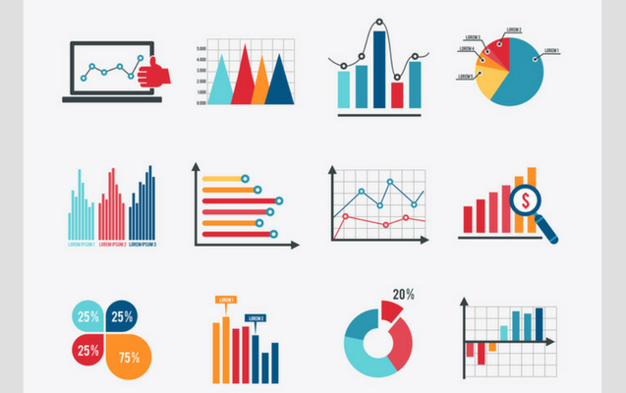
Types of Charts in Excel
Excel offers a wide range of chart types to suit different data and presentation needs.Common chart types include-
Column charts
Bar charts
Line charts
Pie charts
Scatter plots
Area charts
Histograms

Slide 4
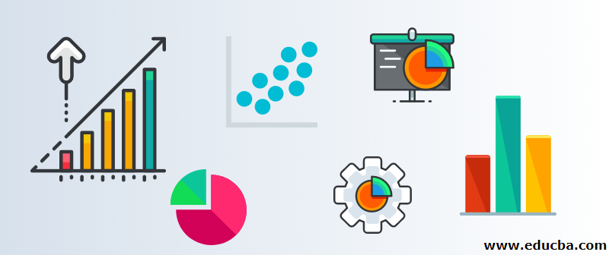
Benefits of Using Charts in Excel
Enhances Data Visualization: Charts make it easier to grasp and interpret data trends, patterns, and comparisons.
Simplifies Data Analysis: Charts provide a visual summary of data, enabling users to analyze information quickly and efficiently.
Enables Effective Communication: Charts help in presenting data in a visually appealing and easily understandable format, facilitating effective communication with stakeholders.
Facilitates Decision-Making: Clear and concise charts enable users to make informed decisions based on data insights.

Slide 5
Application of Charts in the Walmart Dataset
Sales Trends: Create line charts or area charts to visualize sales trends over time, identifying peak periods and seasonality.
Product Category Analysis: Use a bar chart to compare sales across different product categories, highlighting top-selling categories.
Geographical Analysis: Generate a geographic map or a bubble chart to visualize sales distribution across different store locations or regions.
Customer Demographics: Utilize pie charts or bar graphs to represent customer segments based on demographic factors like age, gender, or income.

Slide 6

Chart Business Use Case
Charts in Excel are a powerful tool for analyzing and visualizing data in the Walmart dataset. By leveraging the various charting options available, analysts can gain valuable insights into sales trends, product performance, geographical patterns and customer demographics. Using charts allows for effective data communication, enabling stakeholders to make informed decisions based on clear and intuitive visual representations.

Slide 7
Pivot Tables

Slide 8
Introduction to Pivot Tables
Pivot tables in Excel are powerful tools for data analysis and summarization.
A pivot table is a data summarization tool in Excel that allows users to analyze and manipulate large datasets.
It provides a flexible and interactive way to extract insights by rearranging and summarizing data based on different dimensions and calculations.

Slide 9
Structure and Components of a Pivot Table
Source Data: The original dataset from which the pivot table is created.
Row Labels: Fields or variables used to categorize and group data along the rows of the pivot table.
Column Labels: Fields or variables used to categorize and group data along the columns of the pivot table.
Values: The data being analyzed and summarized within the pivot table, typically aggregated using functions like sum, count, average, etc.
Filters: Criteria applied to filter the data displayed in the pivot table based on specific conditions.

Slide 10
Key Benefits of Using Pivot Tables:
Data Summarization: Pivot tables allow quick and efficient summarization of large datasets, providing insights into patterns and trends.
Data Exploration: Users can easily explore and analyze data from different perspectives by dragging and dropping fields within the pivot table.
Dynamic Updates: Pivot tables automatically update when the source data is modified, ensuring real-time analysis and eliminating manual adjustments.
Customization: Pivot tables offer extensive customization options, such as sorting, filtering, and formatting, to enhance data analysis and visualization.
Interactive Reports: Pivot tables enable users to create interactive reports by incorporating charts, graphs, and slicers for dynamic data visualization.

Slide 11
Application of Pivot Tables in the Walmart Dataset
Sales Analysis: Summarize sales data by product, region, or time period to identify top-selling products or high-performing regions.
Customer Analysis: Analyze customer data by demographics, purchase history, or customer segments to understand customer behavior.
Category Performance: Evaluate the performance of different product categories by summarizing sales and profit data.
Yearly, Quarterly, or Monthly Analysis: Summarize sales data by year, quarter, or month to identify seasonal trends and patterns.

Slide 12
Applications of Pivot Tables in the Walmart Dataset
Sales Analysis: Pivot tables can be used to summarize and analyze sales data by different dimensions such as product, region, customer, or time period.
Category Performance: Pivot tables allow for an evaluation of the performance of different product categories by summarizing sales, profit, and other metrics.
Customer Segmentation: Pivot tables facilitate the segmentation of customers based on demographics, purchase behavior, or other variables, aiding in understanding customer preferences and targeting marketing efforts.
Regional Comparison: Pivot tables can compare sales, profitability, or other metrics across different store locations or regions to identify high-performing areas or areas requiring improvement.

Slide 13
Examples of Pivot Table Analysis
Total Sales by Product Category: Summarize sales data by product category to identify the top-selling categories and analyze their contribution to overall sales.
Sales Trend by Year and Quarter: Analyze sales trends over time by creating a pivot table that showcases sales by year and quarter.
Profitability by Region: Determine the profitability of different regions by summarizing profit data in a pivot table, providing insights into high-profit and low-profit regions.
Customer Segmentation by Age Group: Group customers into age categories and analyze their purchasing behavior, such as average order value or frequency of purchases.

Slide 14
Business Use Case
Pivot tables in Excel provide a flexible and efficient way to analyze and summarize large datasets, such as the Walmart dataset. By utilizing pivot tables, users can gain valuable insights into sales analysis, customer behavior, and category performance. Pivot tables offer a dynamic and interactive approach to data exploration and visualization, facilitating effective decision-making based on clear and concise summaries of complex information.

